Slide 1
CS3081: “Artificial Intelligence”
Knowledge Representation
Logic
Prof Passent Elkafrawy
pelkafrawy@effatuniversity.edu.sa
CoE112, ext 7896

Slide 2
Reading R&N
Chapter 8 First-order logic
.
The slides were inspired from:

Slide 3
What is knowledge
What is Knowledge Representation and Reasoning (KR&R)?
Symbolic encoding of propositions believed by some agent and their manipulation to produce propositions that are believed by the agent but not explicitly stated.
Why KR&R:
Large amounts of knowledge are used to understand the world around us.
Reasoning provides compression in the knowledge we need to store.
Without reasoning we would have to store an infeasible amount of information: Example: Elephants can’t fit into teacups, Elephants can’t fit into cars, instead of just knowing that larger objects can’t fit into smaller objects.

Slide 4
Knowledge
Information: (1) Block A is above block B; (2) Block B is above block C.
Query: Is A above C?
Given the information, human can easily draw the conclusion. How can a machine do the same?

Slide 5
Tony, Mike, and John are members of the Sports Club.
Every member of the Sports Club who is not a skier is a mountain climber.
Mountain climbers do not like rain, and any one who does not likes now is not a skier.
Mike dislikes whatever Tony likes, and likes whatever Tony dislikes.
Tony likes rain and snow.
Is there a member of the Sports Club who is a mountain climber but not a skier?

Slide 6
Logical Representations for KR
Logical representations
are mathematically precise; thus, it’s possible to analyze their limitations, properties, and complexity of inferences.
Are formal languages; thus, computer programs can manipulate sentences in the language.
typically, have well-developed proof theories: formal procedures for reasoning to produce new sentences.
In this module we will study First-Order logic (FOL), and a reasoning mechanism called resolution that operates on First-Order logic.

Slide 7
Logics in general
Language | Ontological Commitment | Epistemological Commitment
Propositional logic | facts | true/false/unknown
First-order logic | facts, objects, relations | true/false/unknown
Temporal logic | facts, objects, relations, times | true/false/unknown
Probability theory | facts | degree of belief
Fuzzy logic | facts + degree of truth | known interval value

Slide 8
First-order logic
Whereas propositional logic assumes world contains facts,
First-order logic (like natural language) assumes the world contains
Objects: people, houses, numbers, theories, Ronald McDonald, colors, baseball games, wars, centuries . . .
Relations: red, round, bogus, prime, multistoried . . ., brother of, bigger than, inside, part of, has color, occurred after, owns, comes between, . . .
Functions: father of, best friend, third inning of, one more than, end of
. . .

Slide 9
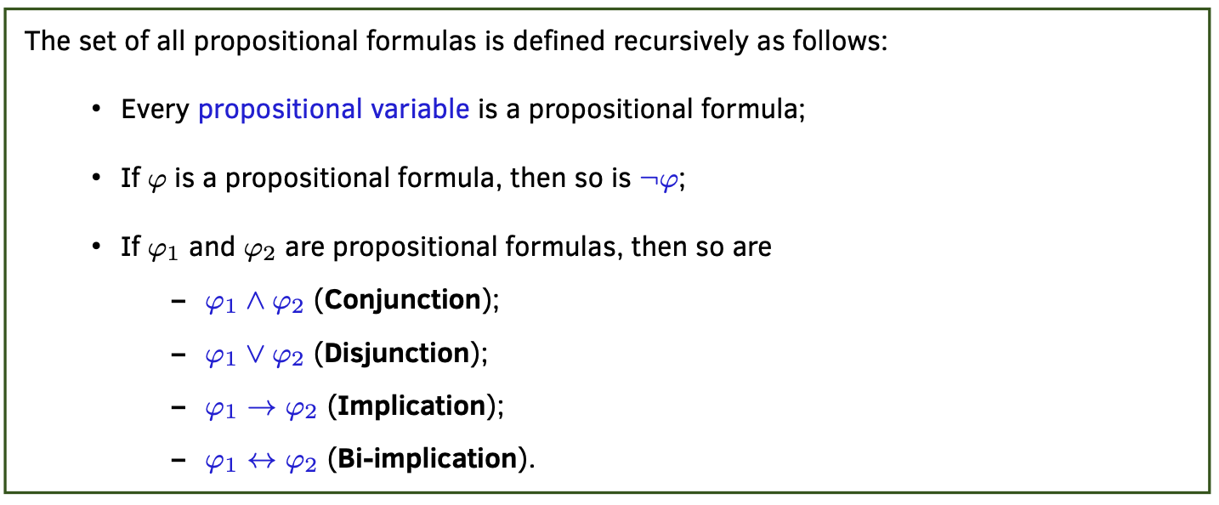
Propositional Logic Syntax
Propositional Variable: A variable which takes only True or False as values.

Slide 10
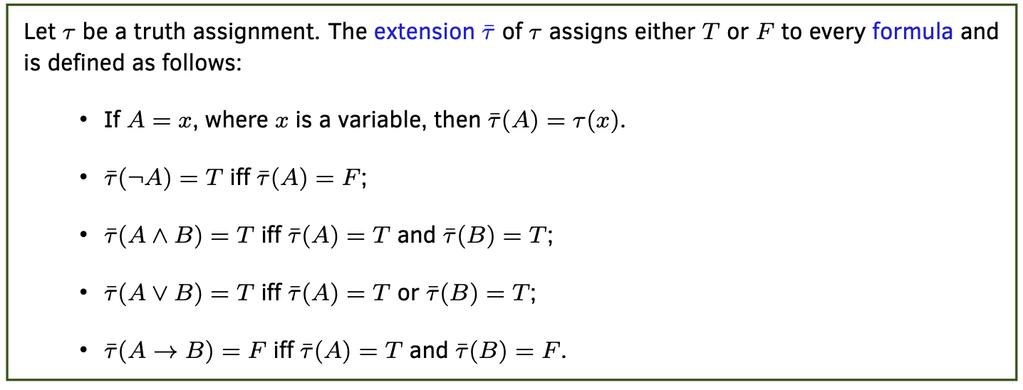
Propositional Logic Syntax
Truth Assignment: A function τ from the propositional variables into the set of truth values {T,F}.

Slide 11
Propositional Logic Syntax
Example: Let V = {p,r,q} be a set of propositional variables and τ1 : V → {T,F} and τ2 :V →{T,F} be two truth assignments s.t.:
τ1(p)=T, τ1(q)=F, τ1(r)=F.
τ2(p)=F, τ2(q)=T, τ2(r)=F.
Then
τ ̄1((¬p ∧ q) → r) =
τ ̄2((¬p ∧ q) → r) =

Slide 12
Propositional Logic Syntax
A truth assignment τ satisfies a formula A iff τ ̄(A) = T . τ satisfies a set Φ of formulas iff τ satisfies all formula in Φ.
A set Φ of formulas is satisfiable iff some truth assignment τ satisfies Φ. Otherwise, Φ is unsatisfiable.
Example: τ(p)=F, τ2(q)=T, τ2(r)=F
Φ1 ={r→(p∧q),¬p}
Φ2 ={r→(p∧q),r∧¬p}

Slide 13
Propositional Logic Syntax
A formula A is a logical consequence of Φ (denoted by Φ |= A) iff for every truth assignment τ , if τ satisfies Φ, then τ satisfies A.
Example:
Let Φ = {r → ((p ∧ q) ∨ s), r ∧ p}.
Then Φ |=

Slide 14
Limitations of Propositional Logic
Only Boolean variables: Without non-Boolean variables cross references between individuals in statements are impossible. Example: ’If a person has a sibling and that sibling has a child, then the person is an aunt or an uncle.’
S: a person has a sibling. C: a sibling has a child. A: a person is an aunt or an uncle. S∧C→A
This approach doesn’t work: person in S and A are not related. sibling in S and C are not related.
No quantifiers: To state a property for all (or some) members of the domain we have to explicitly list them. Example: ’Every member of the Sports Club who is not a skier is a mountain climber’

Slide 15
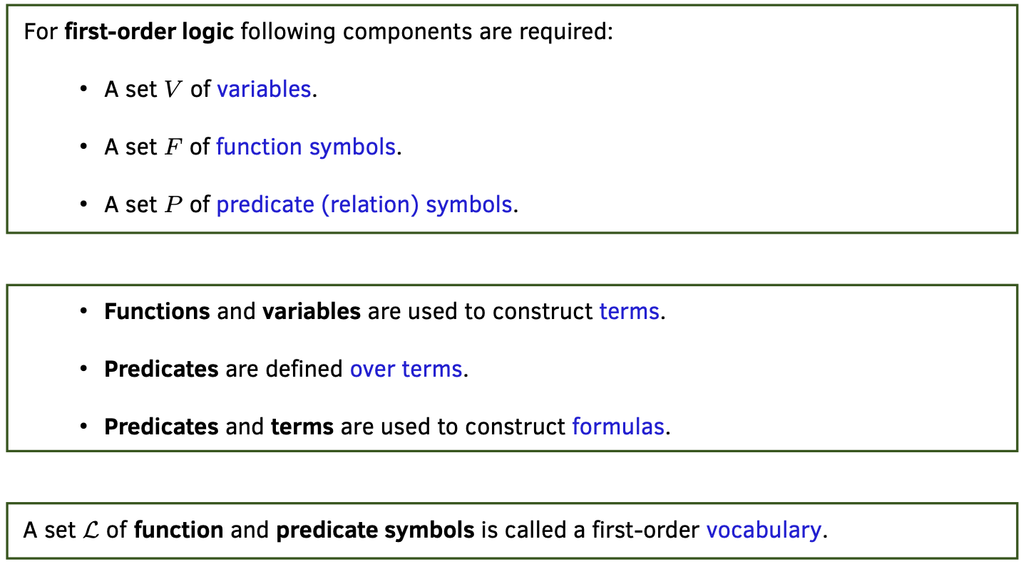
First-Order Logic Syntax

Slide 16
First-Order Logic
Terms (variables and functions) denote elements of the domain.
Atomic formulas denote properties and relations that hold about the elements in the domain.
Other formulas generate more complex assertions by composing atomic formulas.

Slide 17
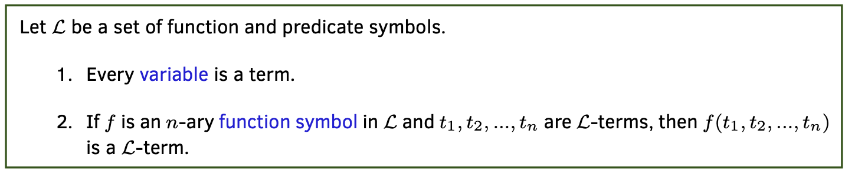
First-Order Logic Syntax
Note: 0-ary functions symbols are called constant symbols. Example:

Slide 18
Converting English to First-Order Language
Individuals: Constants (0-aryFunctions)
tony, mike, john,
rain, snow
Types: Unary Predicates
– AC (x): x belongs to Sports Club.
– S(x): x is a skier.
– C (x): x is a mountain climber.
Relationships: Binary Predicates
L(x,y): x likes y.

Slide 19
Basic Facts: – Tony, Mike, and John belong to the Sports Club:
AC(tony), AC(mike), AC(john)
– Tony likes rain and snow:
L(tony, rain), L(tony, snow)
Complex Facts:
Every member of the Sports Club who is not a skier is a mountain climber.
Mountain climbers do not like rain, and any one who does not like snow is not a skier.

Slide 20
Mike dislikes what ever Tony likes, and likes whatever Tony dislikes.
Is there a member of the Sports Club who is a mountain climber but not a skier?

Slide 21
Properties of quantifiers
∀ x | ∀ y | is the same as ∀ y | ∀ x | (why??)
∃ x | ∃ y | is the same as ∃ y | ∃ x | (why??)
∃ x | ∀ y | is not the same as | ∀ y | ∃ x
∃ x ∀ y Loves(x, y)
“There is a person who loves everyone in the world”
∀ y ∃ x Loves(x, y)
“Everyone in the world is loved by at least one person”
Quantifier duality: each can be expressed using the other
∀ x Likes(x, IceCream)
∃ x Likes(x, Broccoli)
¬∃ x ¬Likes(x, IceCream)
¬∀ x ¬Likes(x, Broccoli)
© 2022 Pearson Education Ltd.

